Slide 1
Today…Linear momentum
Physics 131
Lecture 14
Elastic collisions Mom_{before}=Mom_{after} and KE_{before}=KE_{after}.
Inelastic collisions- Momentum_{before} = Mom_{after} and KE_{before} ≠ KE_{after} .
Centre of mass CoM = Σr m/m_{total}
All found in Young and Freedman, University Physics, chapter 8, sections 4 to 6
Notes:
We have looked at linear momentum.
Today I want to extend this a bit further. We’ll look at the Conservation of momentum in Elastic Collisions, Conservation of momentum in Inelastic Collisions and see what Centre of mass is and how it shows us that we can represent an extended body as a particle.

Slide 2
Review
Find the impulse of a 750 g hammer hitting a nail at 2 m/s.
Does the length of time the hammer acts on the nail effect the magnitude of the impulse J
No, the impulse J = change in momentum
Notes:
Demo- Linear air track
Last lecture we looked at linear momentum, specifically:
Definition of linear momentum (p=mv)
Definition of impulse (J=p2-p1 or force times time)
Impulse-momentum theory(The change in momentum of a particle during a time interval equals the impulse of the net force that acts on the particle during that time interval)
Conservation of momentum (If the vector sum of the external forces on a system is zero, the total momentum of the system is constant).

Slide 3

Emergency Landing

Slide 4
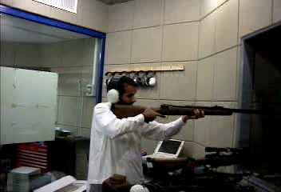

Slide 5
Conservation of momentum
If the vector sum of the external forces on a system is zero, the total momentum of the system is constant.
Notes:
Remember what momentum is …. Mv
The conservation of momentum relates total momentum after a collision to that befrore…
They are equal for all collisions- ignoring firction and other
Remember the notation for the conservation of momentum equation…. 1 is for before…..2 is after…. A is mass A and B I mass B
Here is an interesting example
@
The high mass basketball hits the ground and moves upwward hitting the lower mass tennis ball.
@Here is another example of a high mass- the train hitting a low mass- truck.

Slide 6
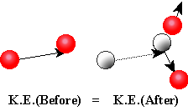
Elastic Collisions
An elastic collision is one where kinetic energy is conserved – the forces between the bodies are conservative so that no mechanical energy is lost in the collision.
Notes:
So momentum is always conserved….
Lets look a the energy in collisions- this would be KE…. 1/2 mv2
Energy may be lost in collsions- depending on whether the collision is elastic or inelastic… .
Demo- Bounce ball- fairly elastic- ie no energy lost….
However, there are three types of collision and whilst the conservation of momentum applies in all cases, conservation of energy does not.
So what are these types of collision ? They are known as Elastic, Inelastic and completely inelastic .
An elastic collision is one where kinetic energy is conserved. The forces between the colliding bodies are conservative so that no mechanical energy is lost in the collision. For instance when two rubber balls collide they will squash a bit, so changing some ke into pe (like for the spring) but they will then unsquash yielding all the stored pe to become ke again.
So Total initial ke = total final ke. I f we have two bodies A and B and they collide the equation as shown applies for the kinetic energy. For the momentum we have initial momentum = final momentum as we saw on the last slide.

Slide 7
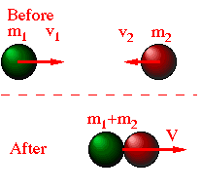
Inelastic Collisions
An inelastic collision is one where kinetic energy is not conserved
Total initial K_{e}
total final K_{e}
We call a collision completely inelastic when the colliding objects stick together after the collision
Notes:
Demo – plastercine…two tennis balls hitting each other….. Rebound- elastic…. With plastercien.. Stick together…. Inelastic….
In the inelastic case Some kinetic energy has been converted to things like heat. An example would be when two cars bounce off each other in a crash. The work done to bend parts of the cars cannot be recovered as kinetic energy.
We call a collision completely inelastic when the colliding objects stick together after the collision.

Slide 8

Inelastic collision and elastic collisions
Notes:
Perfectly eleastic and perfectly ine

Slide 9
Notes:
Here is a collision between a truck and a car…
Which of these collisions are elastic and which are inelastic?
OK
Which of these collisions display conservation of momentum….
All do- add the momentums of each before and after……they are all the same before and alfter
The first one 20 000 and -60 000 before and -40 000 after

Slide 10
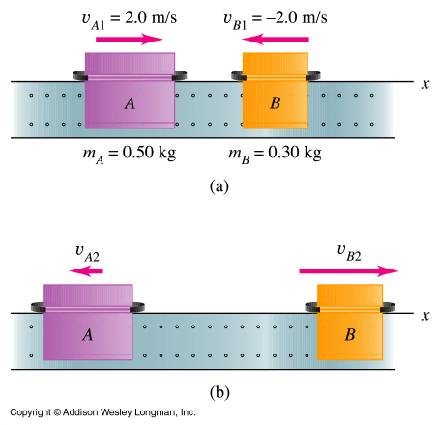
Example 8.10 Elastic collision
Two gliders move toward each other at 2.0 m/s on a frictionless linear air track. Ideal spring bumpers are added to the gliders so that the collision is elastic. If the final velocity of A is –1.0 m/s, what is the final velocity of B after the collision ?
Show that the collision was elastic
Notes:
Let’s do some examples to see the difference between these types of collision
SEE SHEET

Slide 11
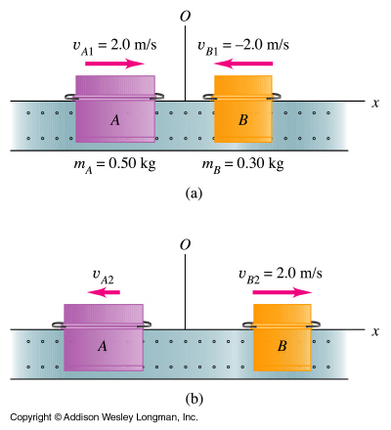
Example: Inelastic collision
The two gliders A and B move toward each other at 2.0 m/s on a frictionless linear air track. After they collide, glider B moves away with a final velocity of +2.0 m/s. What is the final velocity of glider A ?
Show that this is an inelastic collision.
Notes:
Two gliders move toward each other on a frictionless linear air track. After they collide, glider B moves away with a final velocity of +2.0 m/s. What is the final velocity of glider A ?
Here there is no net external force…nothing is pushing on the gliders and there’s no friction. So we can apply our total momentum before = total momentum after.
WE DID THIS ON LAST LECTURE……
SEE PHOTOCOPY.
COMPUTE INITIAL AND FINAL KE.

Slide 12
Completely inelastic collision
This is the same collision as the last one, however, now let’s assume that the two gliders do not bounce but stick together after the collision. Find the common final velocity v₂ and compare the initial and final energies.
Notes:
Completely inelastic collision
SEE PHOTOCOPY.

Slide 13
Since elastic, KE_{b}=KE_{a}
A steel ball of mass m₁ = 1.0 kg traveling along a track at a velocity v₁ = 4.0 m.s⁻¹ collides elastically with another stationary steel ball of mass m₂ = 2.0 kg. What is the kinetic energy of the system before collision? Note that v₂ the initial velocity of the 2.0 kg ball is zero. Let v₁ and v₂ be the velocities after the collision.
½ m₁ v ₁² + ½m₂v₂² = ½ x 1 kg x (4 m.s⁻¹)² +0
= 8 J
What is the kinetic energy of the system after the collision?
Total momentum p_{T}= m₁v₁ + m₂v₂ = 1 kg x 4 m.s⁻¹ + 0 = 4 kg. m.s⁻¹
What is the total momentum of the system before the collision?
What is the total momentum of the system after the collision?
Momentum is conserved,
thus Total momentum p_{T} = 4 kg. m.s⁻¹

Slide 14
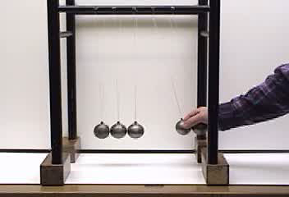
Newtons cradle

Slide 15


Slide 16
Centre of mass
The centre of mass is a mass-weighted average position of the particles in a system. In a uniform gravitational field it is the same as the centre of gravity (which is a single point at which the gravitational force can be considered to act).
And similarly the y cm can be found-
Notes:
I now want to describe the quantity centre of mass…it is a mass-weighted average position of the particles in a system. In a uniform gravitational field it is the same as the centre of gravity (which is a single point at which the gravitational force can be considered to act). It’s position is represented as shown. You can consider a system of particles as if it was one particle with the total mass acting at the centre of mass of the system. Remember that r is a vector and so we can split it into its x and y components.

Slide 17
Example CoM. Find the CoM in the x and y directions

Slide 18
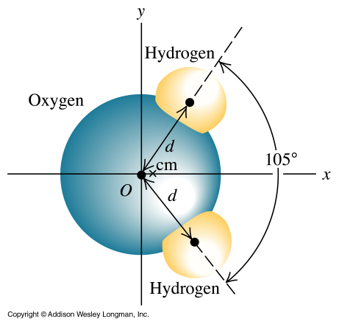
Example 8.14 Centre of mass
The diagram shows a simple model of the structure of a water molecule. The separation between the centre of atoms is d = 9.57 x 10⁻¹¹m. Each hydrogen atom has mass 1.0 u, and the oxygen atom has mass 16.0 u. Using the coordinate system shown, find the position of the centre of mass
Notes:
Let’s do an example
The diagram shows a simple model of the structure of a water molecule. The separation between the centre of atoms is d = 9.57 x 10⁻¹¹m. Each hydrogen atom has mass 1.0 u, and the oxygen atom has mass 16.0 u. Using the coordinate system shown, find the position of the centre of mass
Here have assumed that can represent each atom as a point …nearly all the mass is concentrated in the nucleus which is 10⁻⁵ times the overall radius of the atom.
See sheet

Slide 19
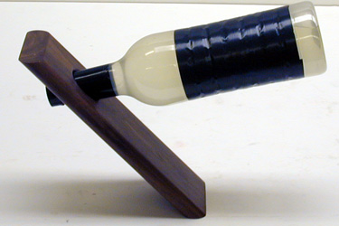
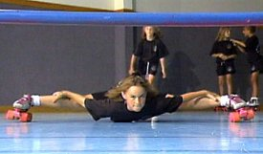
Center of Mass This “Roller limbo” comes from the island of Trinidad- where people have to bend over backwards to pass under the bar

Slide 20
Centre of Mass
The centre of gravity is the point about which the weight of an object exerts no torque.
Take any shaped object…
Does it rotate ?
If yes, then you haven’t located
the centre of mass ?
Suspend it here
No ! Then you have NOW located
the centre of mass ?
CoM

Slide 21
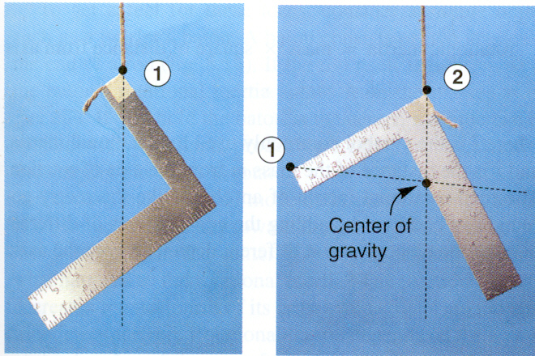
Locating the CoM- where ever it is hung from- the string line passes through the CoM
Centre of gravity
(1)
(2)
Notes:
Demo…..

Slide 22
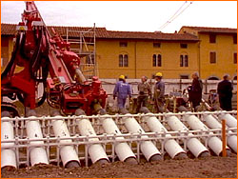
Leaning Tower of Pisa
If the Center of mass moves outside one of the base edges- it tips over
Soil extraction method
Notes:
Soil was frozen initailly- didn’t work
Now just drill to remove soil from uphill side- and can move back- not much point sitting it up straight because wouldn’t be the leaning tower anyore

Slide 23
CoM
For analysis of torque, the weight of a rigid object can be considered as acting through its CoM
Take a plank of wood…
CoM
mg
It will balance…
It will balance…
It will fall !
mg
fulcrum
mg
mg

Slide 24
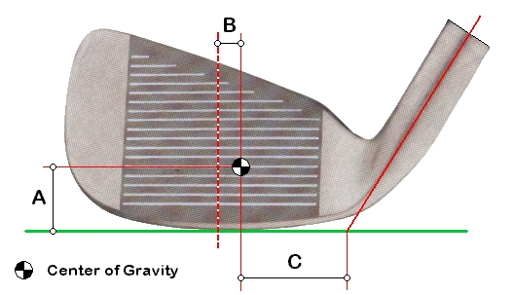
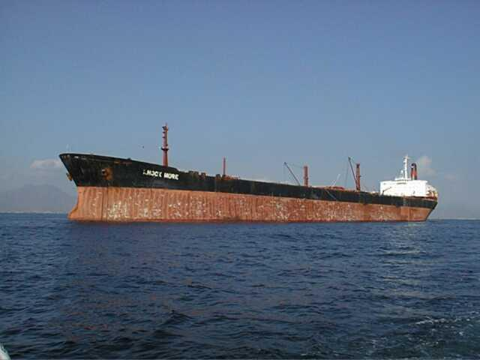
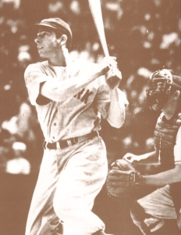
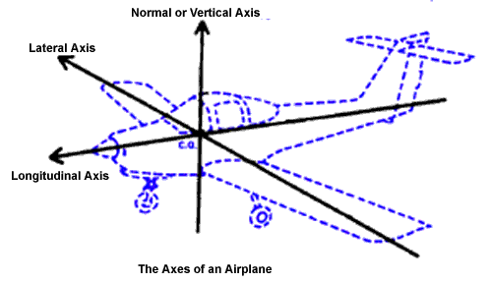
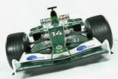
CoM
Notes:
Need to have a low center of gravity to be stable……for ships and cars…. VW cars even slope the wheels in to create a low center of gravity….
A few months ago there were court cases in the USA because Toyota Land cruisers were tipping over at high speed- wheel base too narrow….
What is a “sweet spot” in a bat or racquet ?
Joe DiMaggio used CoG to find the “sweet spot” in baseball bats
56-consecutive-game hitting streak in 1941

Slide 25
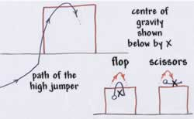
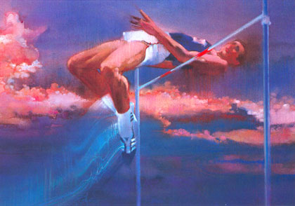

CoM in “Fosbury Flop” high jumping, and long jump

Slide 26
CoM in Orbiting Stars and Planets

Slide 27
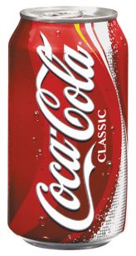
CoM of Coke
The centre of mass of a full coke can obviously is at the centre and will go down as the level of coke in the can is decreased. When the can is empty, however, the centre of mass is back at the centre.
If you know the weight of the empty can and the weight of the full can, can you determine at what level of coke the centre of mass will be at its lowest point?
To make the calculations in your head easier assume that the can is a perfect cylinder and that the empty can weighs 40 grams. It holds 320 ml, therefore the total weight when full is 360 grams. The can is 12 cm high.
Determine the level of coke at which the centre of mass will be lowest. It is possible to solve this without calculus

Slide 28
S= Mass of Soda
x height of soda
C=Mass of Can
H=height of can
r=ratio of mass of the soda to the mass of the can. D=Distance of the center of gravity to the bottom. D=(S*x/h*x/2+C*H/2)/(S*x/H+C)
Substituing C=S/r and simplifying: D=(r*x^2+H^2)/(2*(r*x+h))
Derivating respect x: dD/dx=(r*(r*x^2+2*H*x-H^2))/(2*(r*x+H)^2)
Equaling to Zero x=H*(SQR(r+1)-1)/r and sustituing to D: D=H*(sqr(r+1)-1)/r coincident with the level of soda.

Slide 29
